Slide 1
Naive Bayes Implementation
Dr. Kavita S. Oza

Slide 2
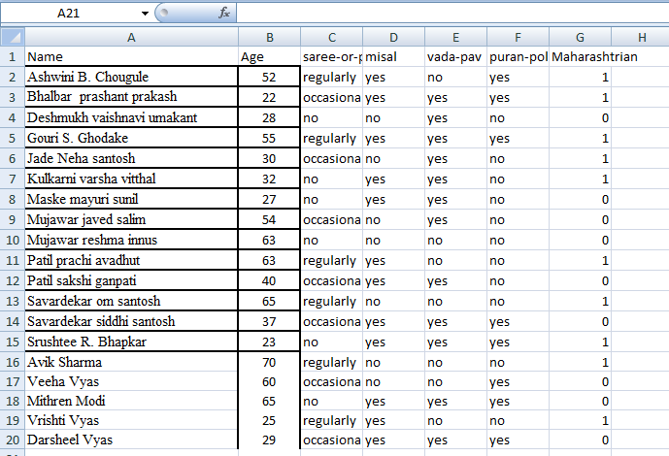
Data set

Slide 3
Importing libraries
import numpy as np
import matplotlib.pyplot as plt
import pandas as pd
import sklearn

Slide 4
Loading dataset
df=pd.read_csv('D:\kso\PGDDS\Dataset\Maharashtrian.csv')
d={'regularly': 0, 'occasionaly': 1, 'no':2}
e= { 'no':0, 'yes': 1}
f= {'no':0, 'yes':1}
g= {'no':0,'yes':1}
df['saree-or-pheta'] = df['saree-or-pheta'].map(d)
df['misal']=df['misal'].map(e)
df['vada-pav']=df['vada-pav'].map(f)
df['puran-poli']=df['puran-poli'].map(g)

Slide 5
Separating features and class
features = ['Age','saree-or-pheta','misal','vada-pav','puran-poli']
X= df[features]
Y = df['Maharashtrian']
print(X)
print(Y)

Slide 6
Dataset splitting
from sklearn.model_selection import train_test_split
X_train, X_test, Y_train, Y_test=train_test_split(X,Y,test_size=0.20,random_state=0)

Slide 7
Feature Scaling
Feature Scaling is a technique to standardize the independent features present in the data in a fixed range.
It is performed during the data pre-processing to handle highly varying magnitudes or values or units.
Standardization involves rescaling the features such that they have the properties of a standard normal distribution with a mean of zero and a standard deviation of one.
from sklearn.preprocessing import StandardScaler
sc=StandardScaler()
X_train=sc.fit_transform(X_train)
X_test=sc.transform(X_test)

Slide 8
Training the model
from sklearn.naive_bayes import GaussianNB
clf=GaussianNB()
clf.fit(X_train, Y_train)
Naive Bayes assumes that each class follow a Gaussian distribution.

Slide 9
Predict the test results
Y_pred=clf.predict(X_test)
Y_pred
Y_test

Slide 10
Evaluate the result
from sklearn.metrics import confusion_matrix,accuracy_score
cm=confusion_matrix(Y_test, Y_pred)
ac=accuracy_score(Y_test, Y_pred)
ac
cm

Slide 11
70:30 split
X_train, X_test, Y_train, Y_test=train_test_split(X,Y,test_size=0.30,random_state=0)
from sklearn.preprocessing import StandardScaler
sc=StandardScaler()
X_train=sc.fit_transform(X_train)
X_test=sc.transform(X_test)
from sklearn.naive_bayes import GaussianNB
clf1=GaussianNB()
clf1.fit(X_train, Y_train)

Slide 12
Accuracy
from sklearn.metrics import confusion_matrix,accuracy_score
cm=confusion_matrix(Y_test, Y_pred)
ac=accuracy_score(Y_test, Y_pred)
ac
cm

Slide 13
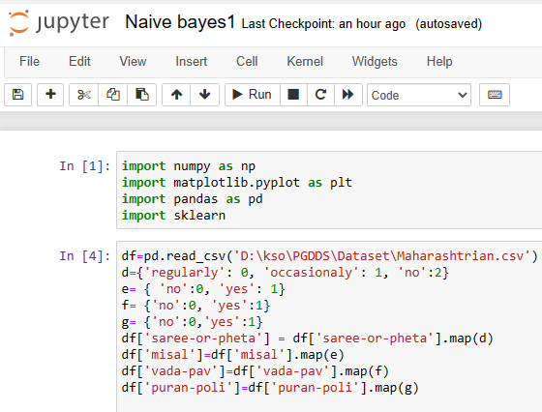
Program at a glance

Slide 14
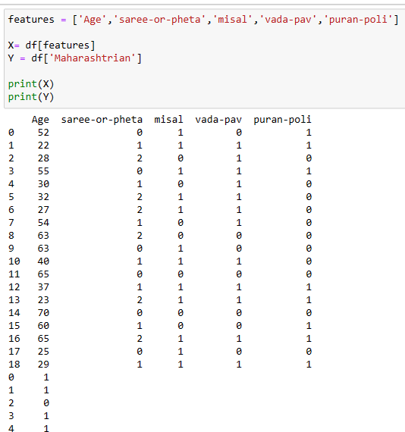
Program at a glance…

Slide 15
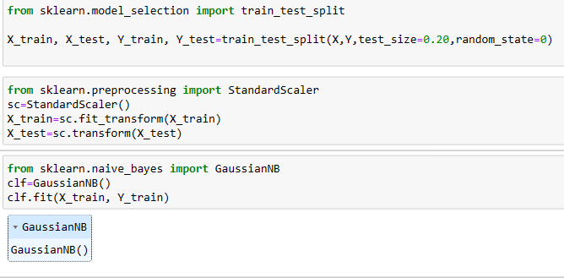
Program at a glance…

Slide 16
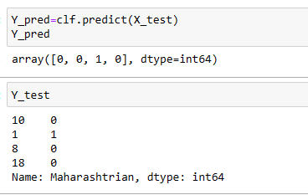
Program at a glance…

Slide 17
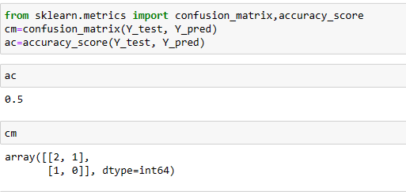
Program at a glance…

Slide 18
With BernoulliNB
It is based on the Bernoulli Distribution and accepts only binary values, i.e., 0 or 1.
If the features of the dataset are binary, then Bernoulli Naive Bayes is the algorithm to be used.

Slide 19
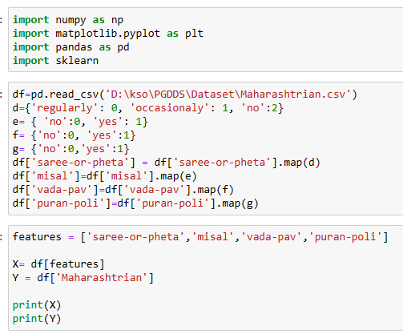
With BernoulliNB…

Slide 20
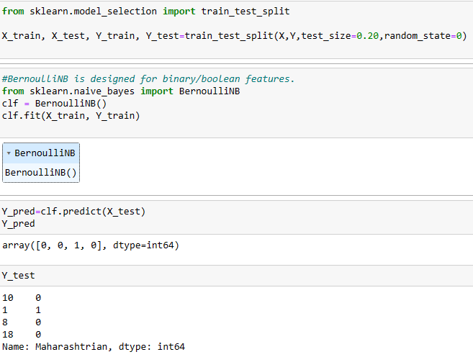
With BernoulliNB…

Slide 21
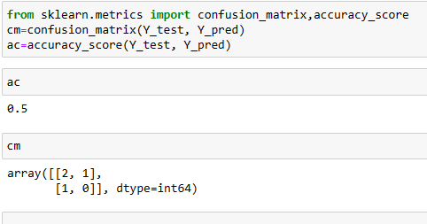
With BernoulliNB…

Slide 22
Thank You

